Slide 1
Three into one
Coloured lights can be mixed to make new colours.
Red light and green light add together to make yellow light.

Slide 2
Three into one
What happens when blue light is added as well?

Slide 3
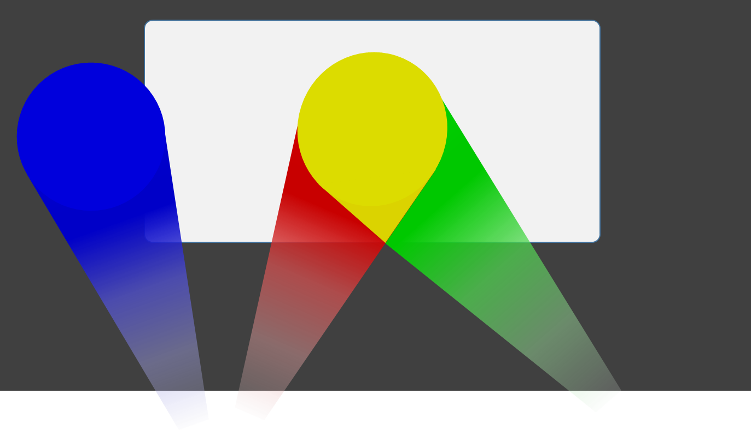
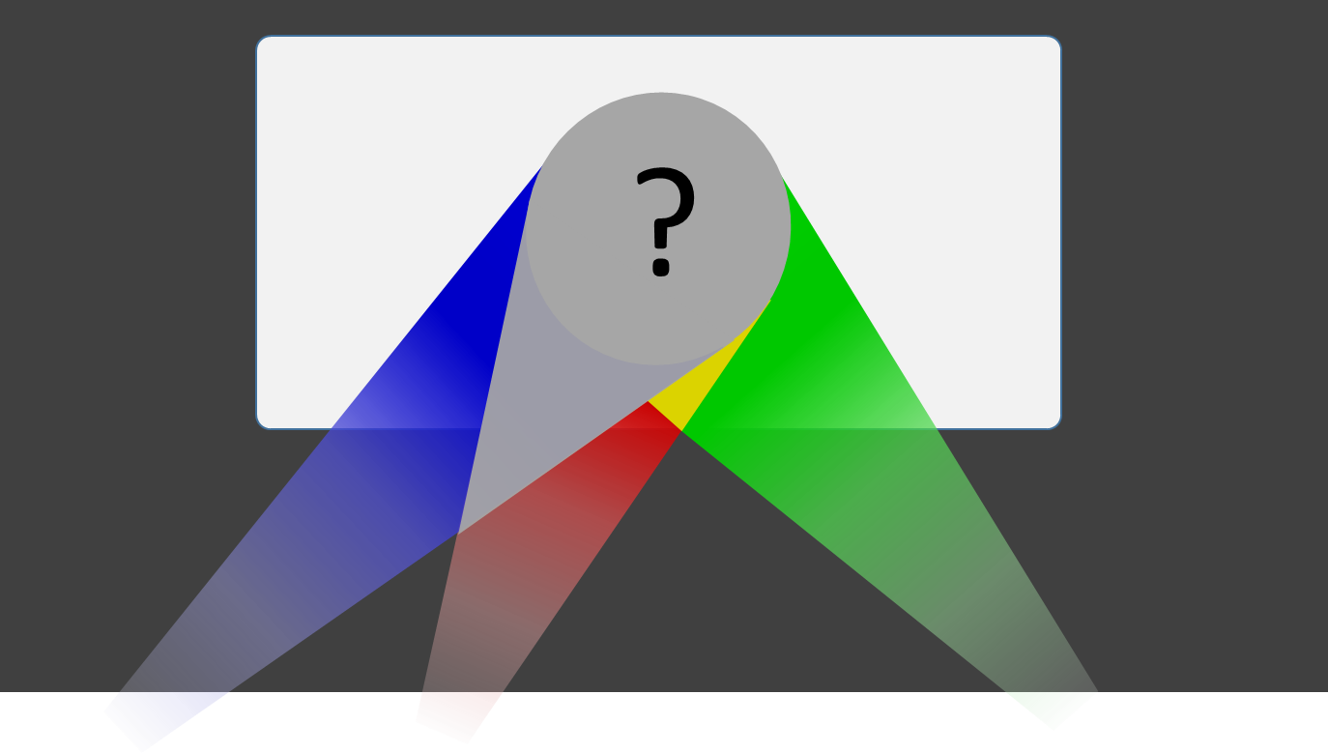
Three into one
Which descriptions of the new colour do you think are right?
It is green
It is white
It is brighter than the yellow

